Slide 1


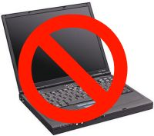
Please
www.yesbu.org

Slide 2
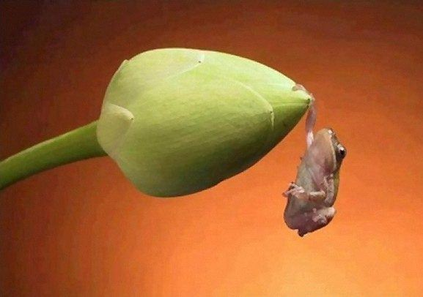
www.youtube.com/watch?v=Y6hz_s2XIAU

Slide 3
فكر معايا

Slide 4
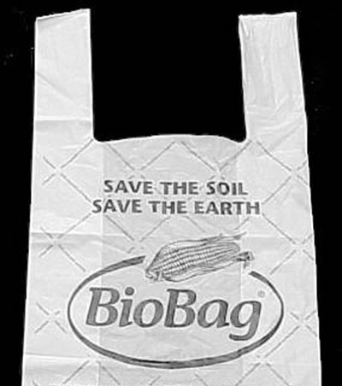
كيس فرنسا

Slide 5

كيس فرنسا

Slide 6
فكر معايا

Slide 7
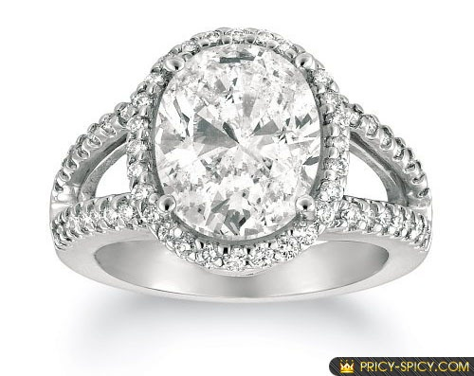

Slide 8
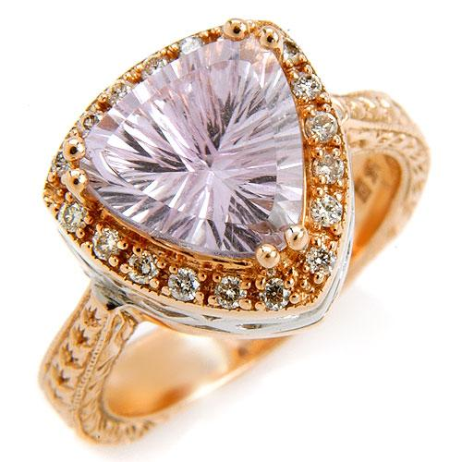

Slide 9
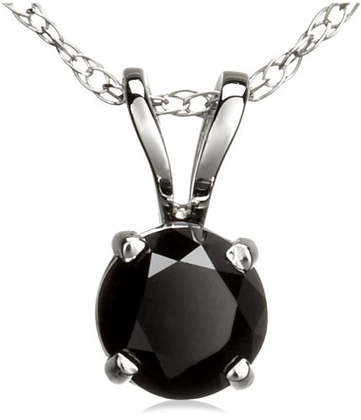

Slide 10
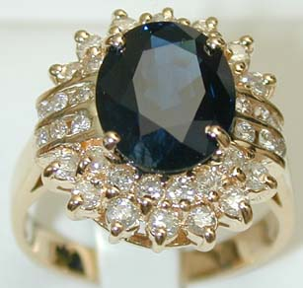

Slide 11
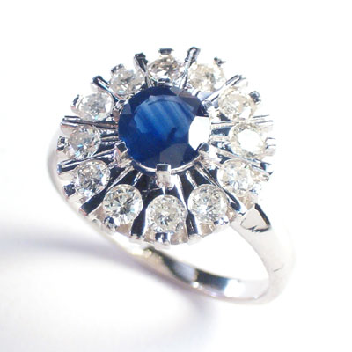

Slide 12
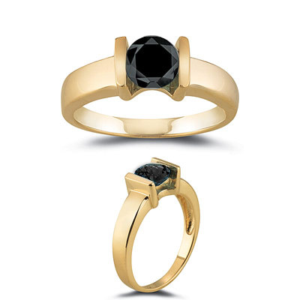

Slide 13
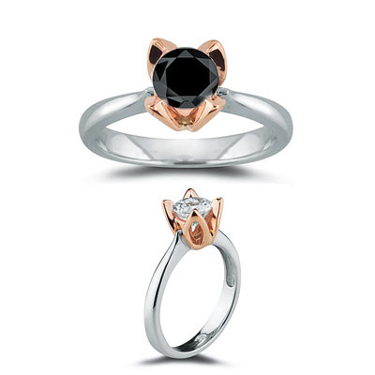

Slide 14
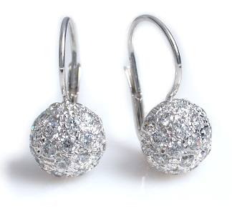

Slide 15
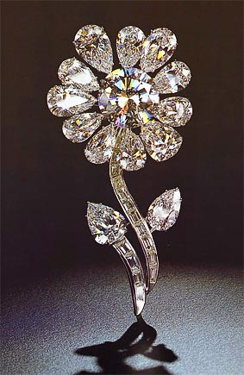

Slide 16
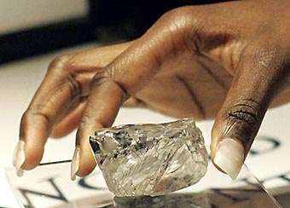

Slide 18

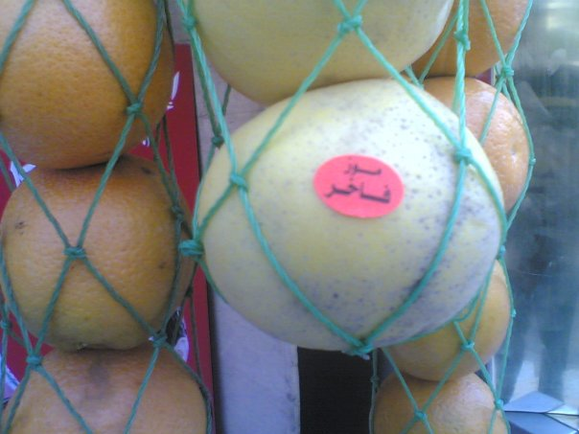
e-mails

Slide 19

A MOBILE PHONE/COMPUTER
WITH EXPANDABLE SCREEN

Slide 20
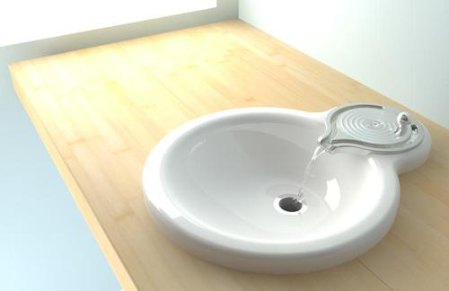

Slide 21
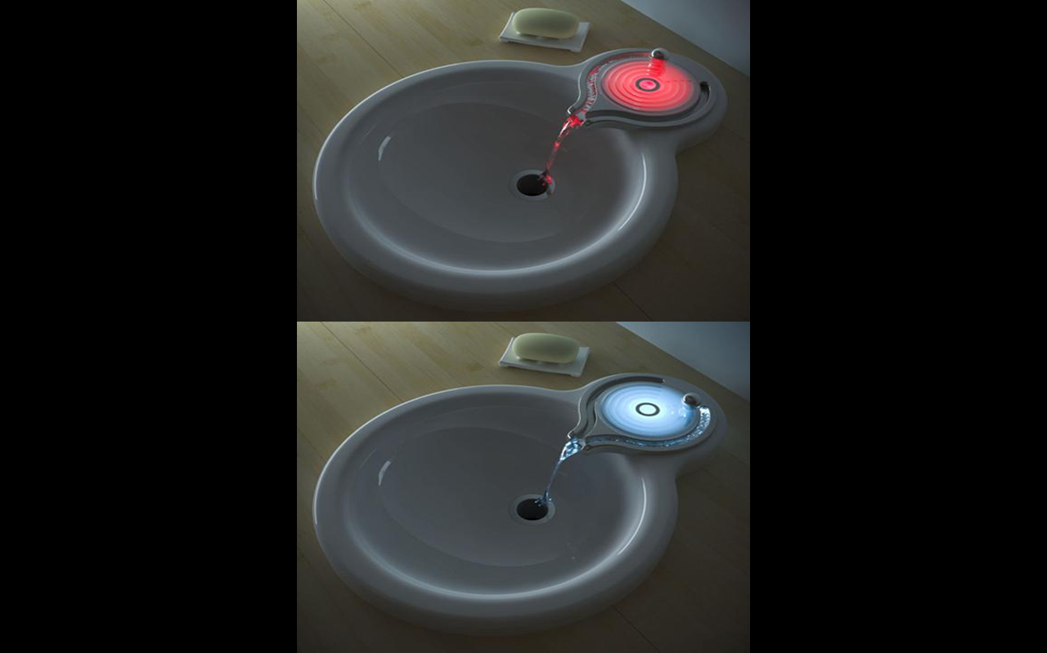
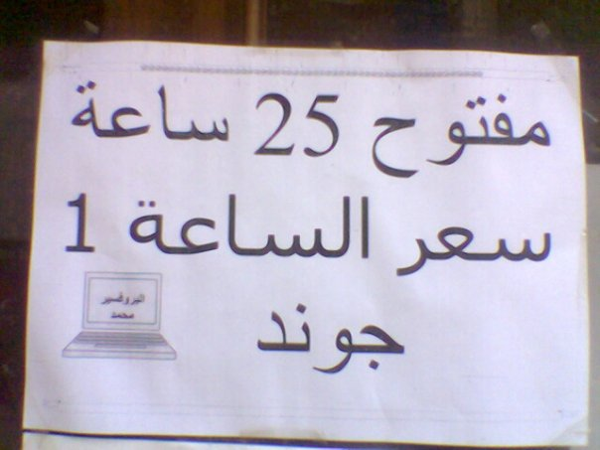
e-mails

Slide 22
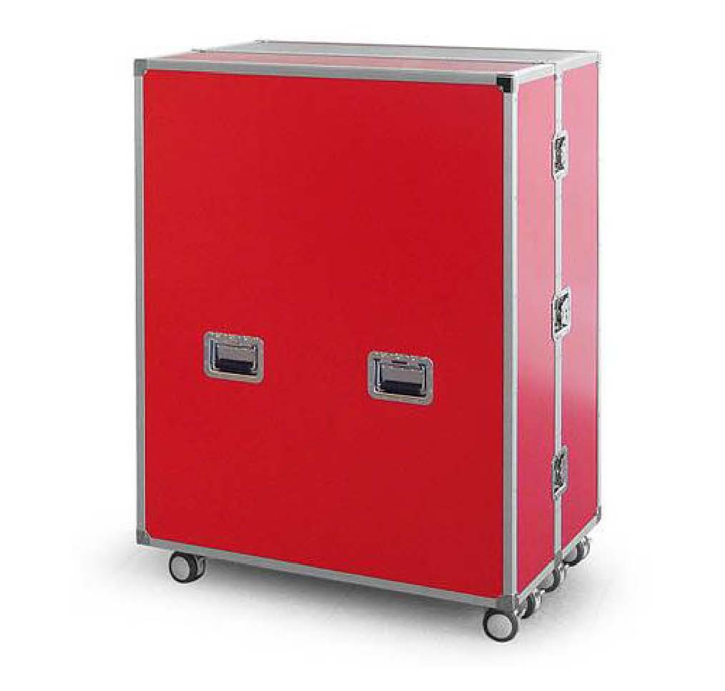
e-mails

Slide 23
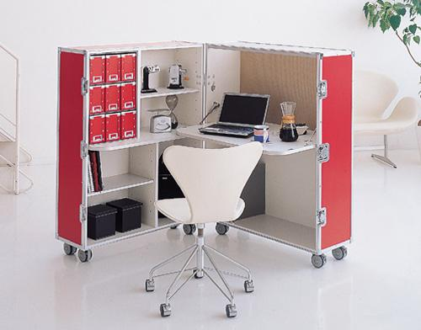
e-mails

Slide 24

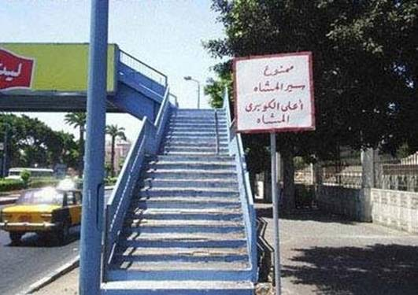
e-mails

Slide 25
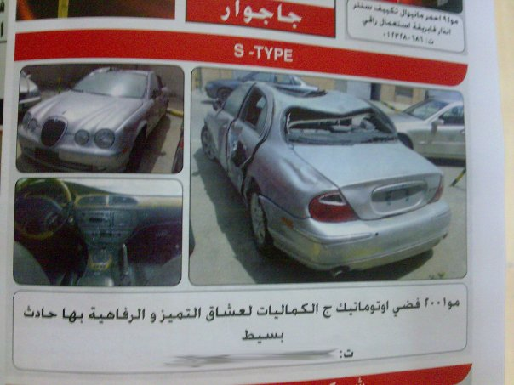

Slide 26
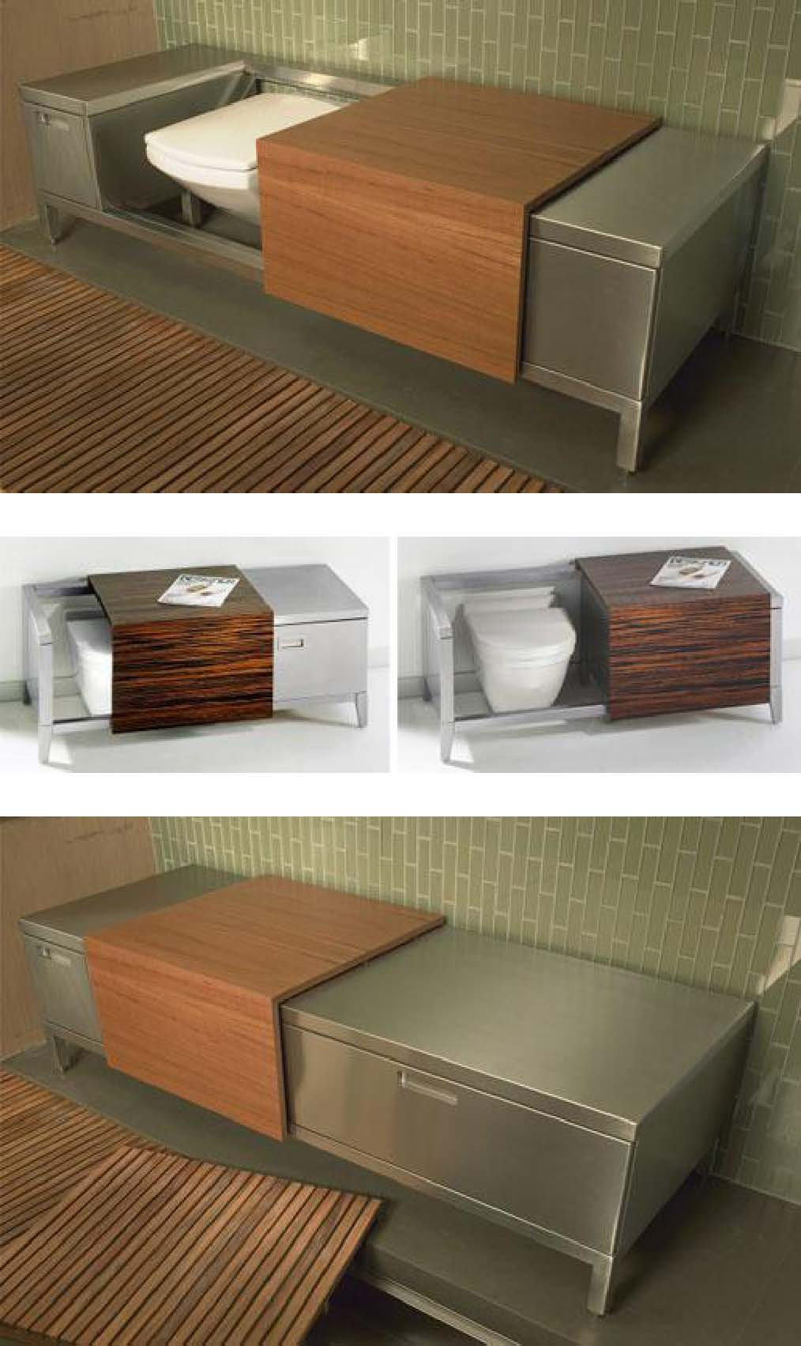

Slide 28

e-mails

Slide 29
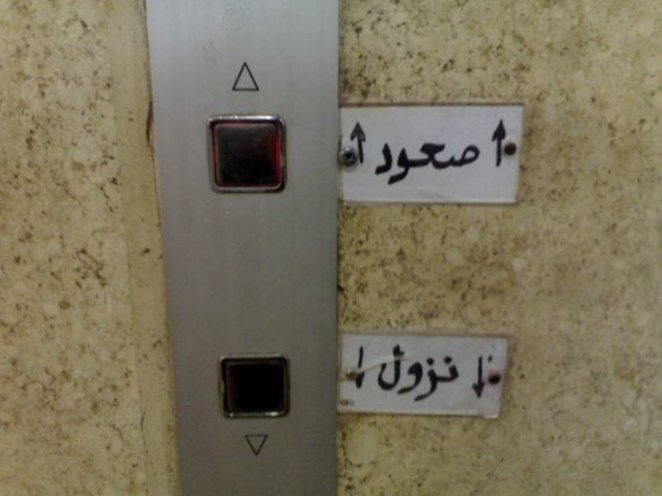

Slide 30
فكر معايا

Slide 31
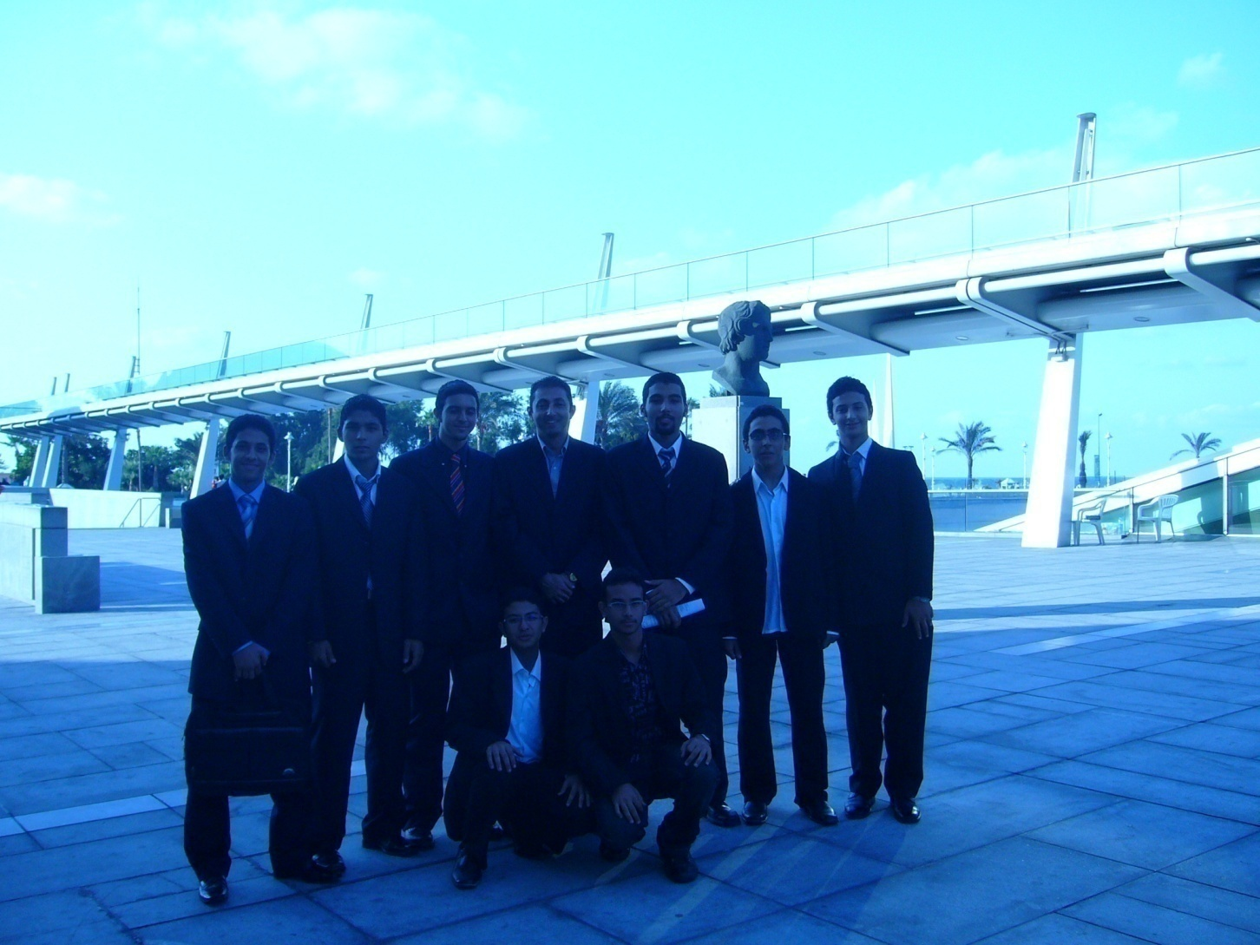
In Or Out

Slide 32
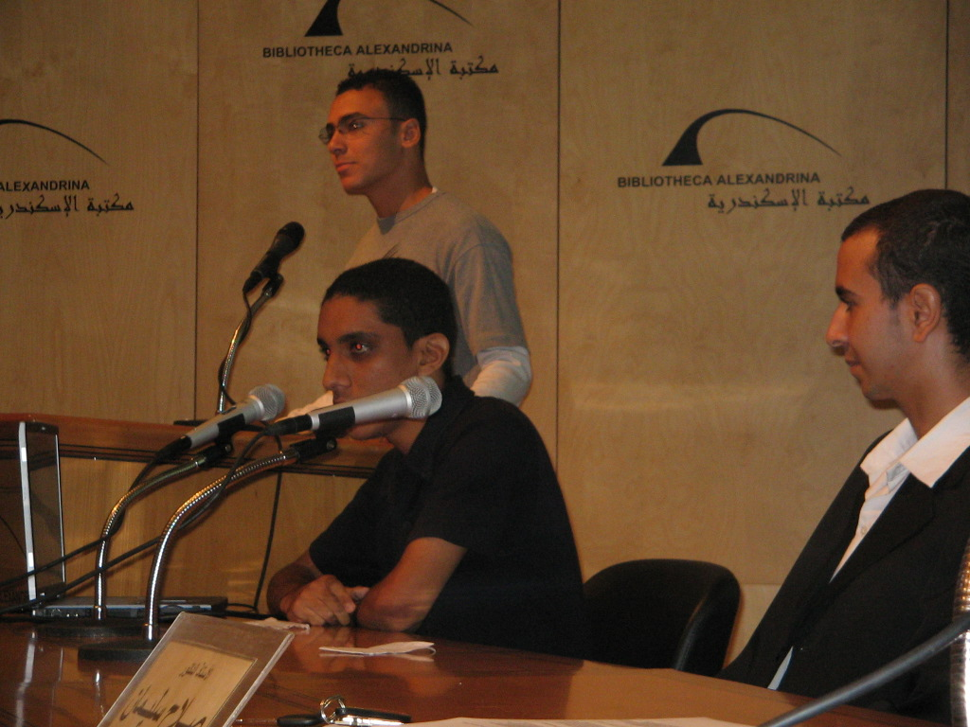

Slide 33
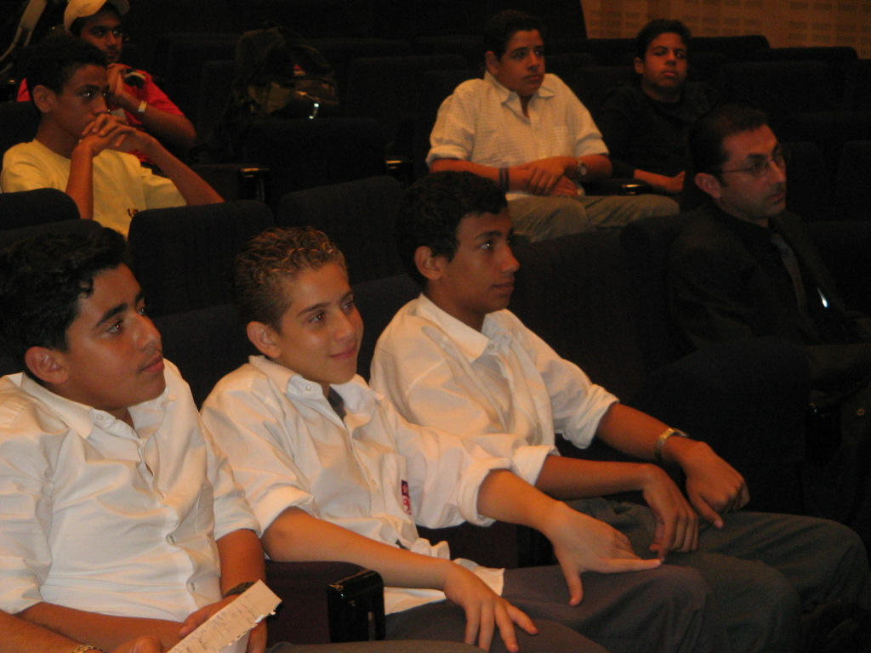
15/10/2005

Slide 34
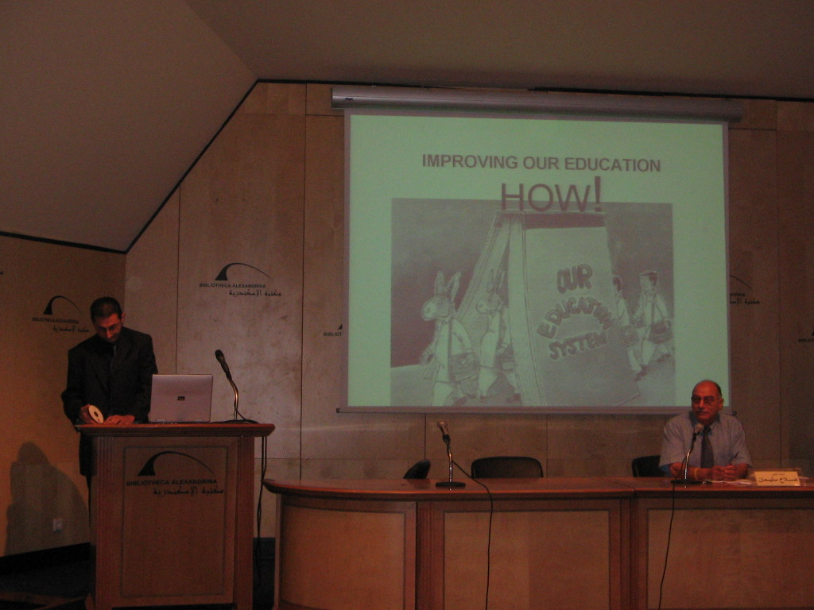

Slide 35
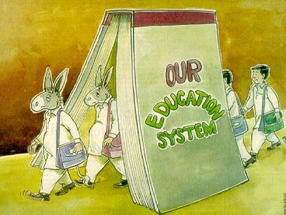

Slide 37
Don’t limit
your challenges
Challenge
your limits

Slide 38
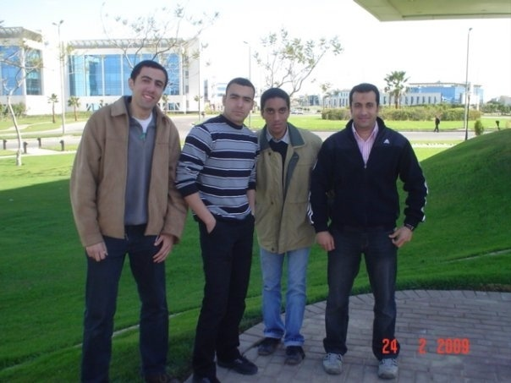

Slide 39
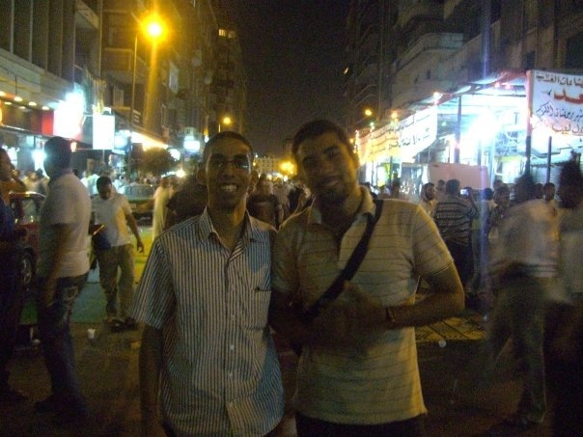

Slide 40
فكر معايا

Slide 41
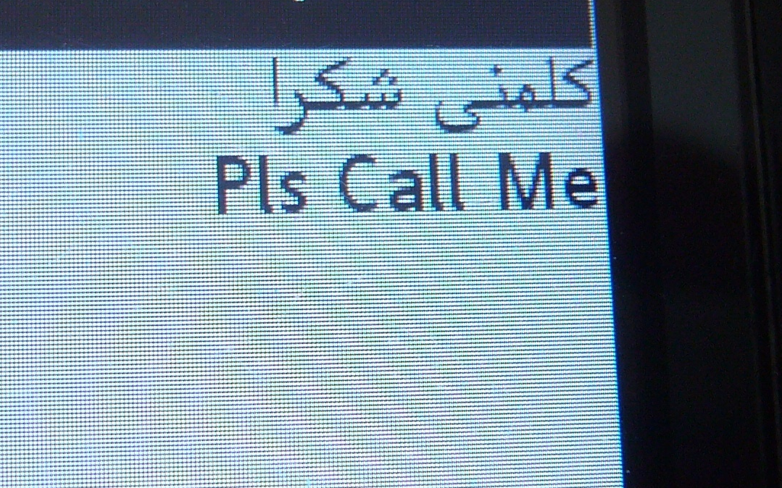
0101 94 40 49

Slide 42
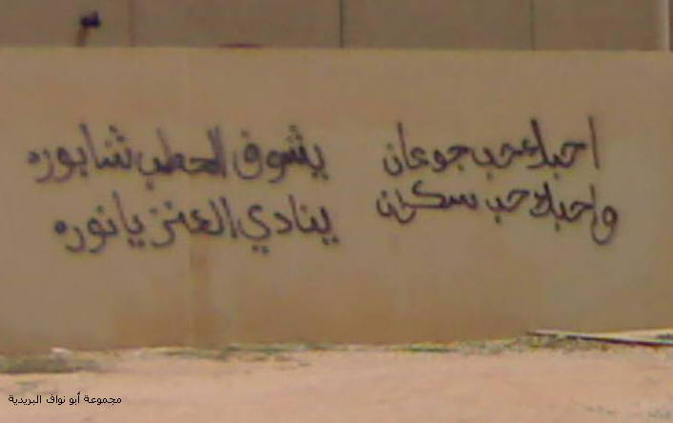

Slide 43
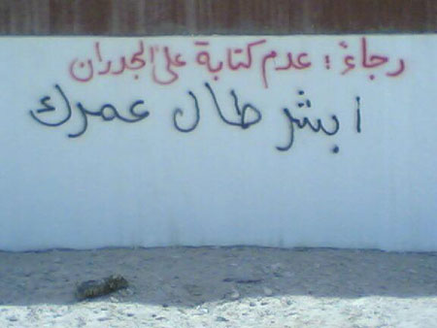

Slide 44
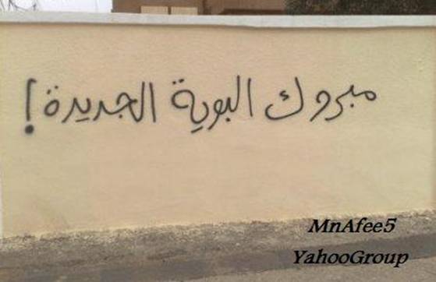

Slide 45
فكر معايا

Slide 46
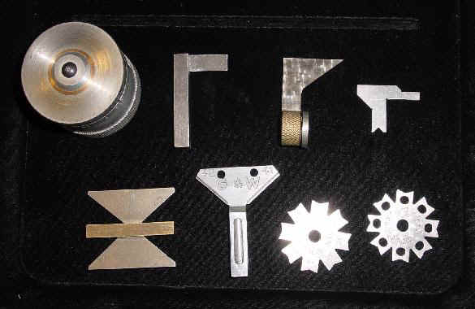

Slide 47
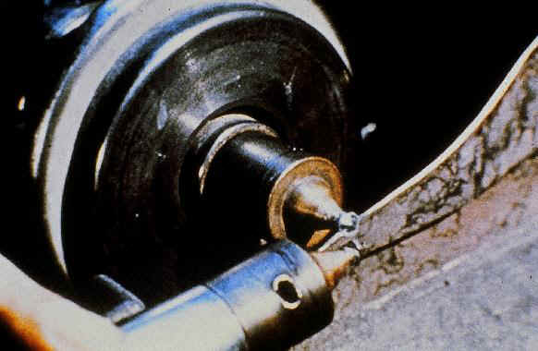

Slide 48
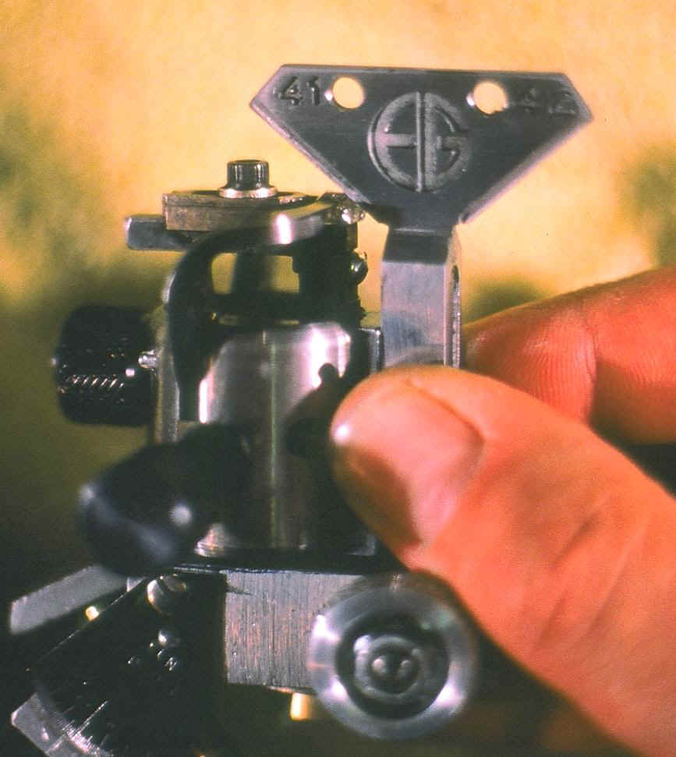

Slide 49
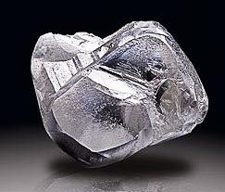

Slide 50
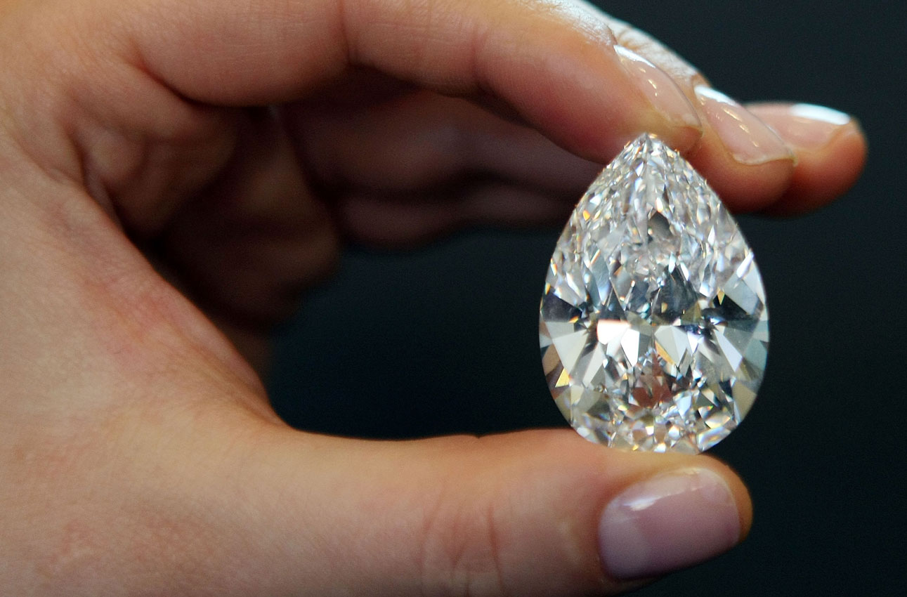

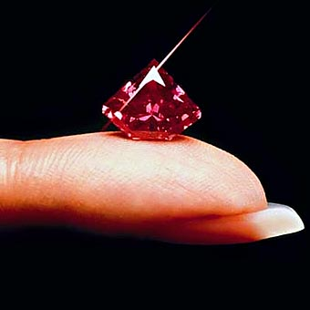

Slide 51
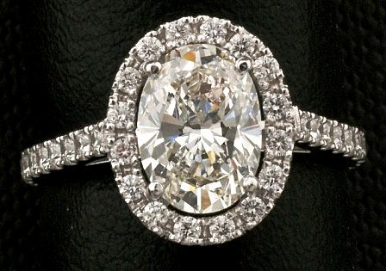

Slide 52
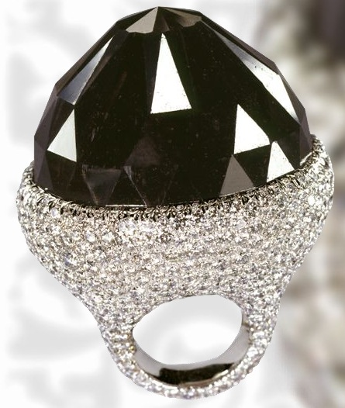

Slide 53
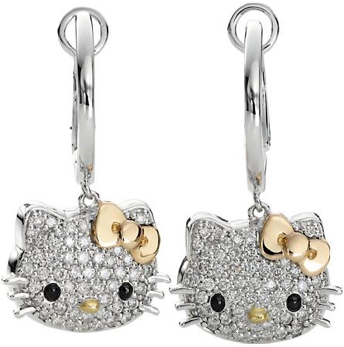

Slide 54
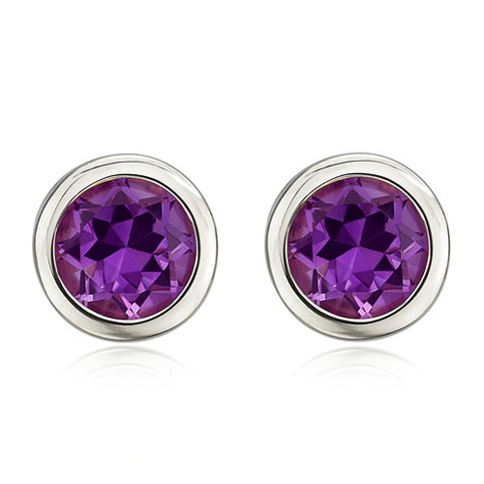

Slide 55
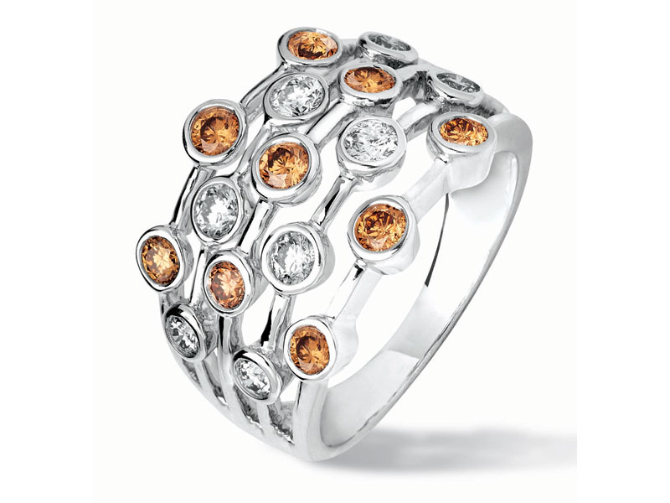

Slide 56
فكر معايا

Slide 57
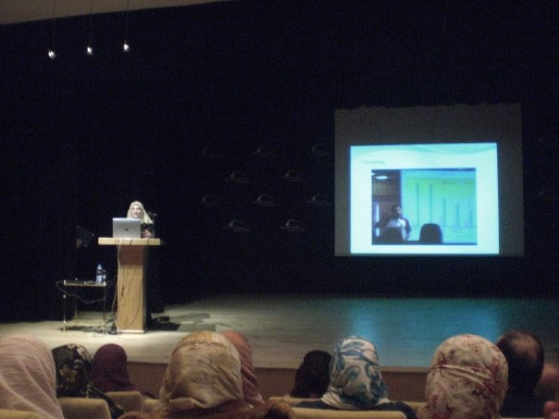

Slide 58
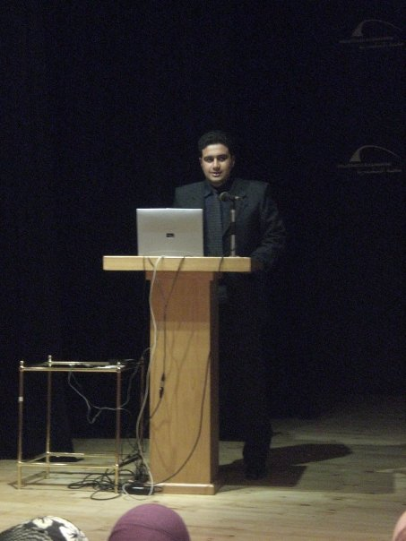

Slide 59
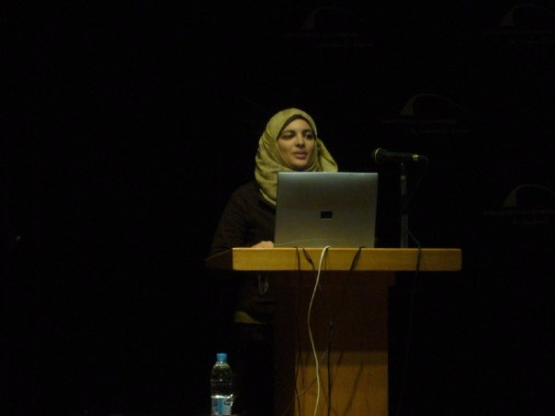

Slide 60
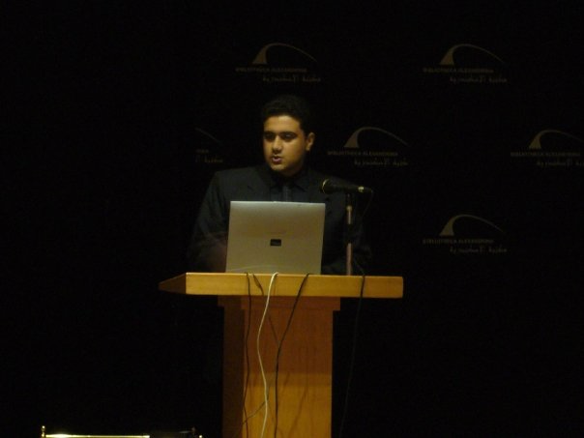

Slide 61
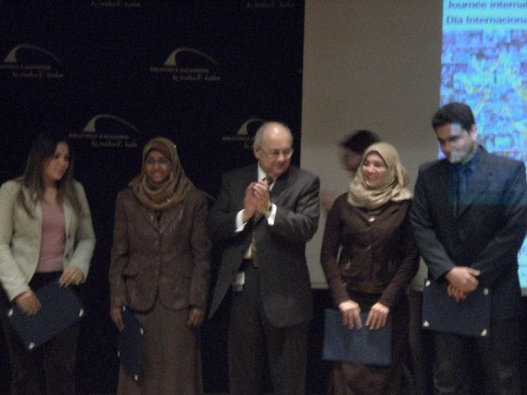

Slide 62


Slide 63


Slide 64


Slide 65


Slide 66


Slide 67


Slide 68


Slide 69


Slide 70


Slide 71


Slide 72


Slide 73


Dr. Salah

Slide 74


Slide 75
“Until this moment,
I never understood
how hard
it was to Lose something
you never had.”

Slide 76


Slide 77
“Farmers don’t grow crops.
They create the conditions for crops to grow.” - Gareth Morgan

Slide 78
سورة الواقعة - سورة 56 - عدد آياتها 96
بسم الله الرحمن الرحيم
أَفَرَأَيْتُم مَّا تَحْرُثُونَ
أَأَنتُمْ تَزْرَعُونَهُ أَمْ نَحْنُ الزَّارِعُونَ

Slide 79


Slide 80


Slide 81
فكرت

Slide 82


Slide 83


Slide 84


Slide 85


Slide 86


Slide 87


Slide 88


Slide 89


Slide 90


Slide 91


Slide 92


Slide 93


Slide 94
فكرت
حتعمل ؟؟؟

Slide 95


Slide 96


Slide 97
كيس فرنسا

Slide 99



Slide 100


www.yesbu.org
أحمد
المصرى
ahmed_refaat30@hotmail.com

Slide 102

www.biobagusa.com www.biobags.co.uk
Naturally, making bags from crops instead of polyethylene is a major advance
in environmental technology… but we don’t stop there.
Did you know we only use GMO free certified crops?
Or that our soy-based inks and dyes are CEN certified for restricted use of heavy metals?
Or that we’re DEBIO certified for use in organic agriculture?
Why do we set such high standards?
Because… Nature Knows The Difference.

Slide 103


